Slide 1
Equity in the Classroom:
Strategies that build relationships, promote student voice, and develop the whole-child.
Denisha Saucedo 2018 PSESD Regional Teacher of the Year Mandy Manning 2018 National Teacher of the Year

Slide 2
Session Overview
In this session, our plan is to explore strategies for building student-teacher relationships. This will be a chance to explore why student voice, and both teacher and student self-efficacy have a high effect on student achievement.
In a nutshell: We hope this session will prepare teachers and administrators to head back to their building and look at class policies and make systemic changes that emphasize SEL for both teachers and students.

Slide 3
Objectives
Educators will have strategies that strengthen teacher-student relationships, elevate student voice and self-efficacy.
Educators will understand the importance of SEL and equity-based strategies and their impact on student achievement.
Educators will begin to develop and understanding of bias and racial equity and its impact on student achievement.

Slide 4
Washington State K-12 Social Emotional Learning Standards
Self-efficacy: Individual has the ability to motivate, persevere, and see oneself as capable.
Social awareness: Individual has the ability to take the perspective of and empathize with others from diverse backgrounds and cultures.
Social management: Individual has the ability to make safe and constructive choices about personal behavior and social interactions.

Slide 5
Humans of Our Communities
https://www.instagram.com/humansofny
Directions:
Find a partner - someone you do not know
Actively listen to your partner for 2 minutes - find their story (you may only ask clarifying or follow-up questions - no storytelling as the listener)
Switch roles
Notes:
I can lead this - we’ll look at a couple of stories from the instagram account and then have the participants follow the instructions on the slide - I’ll call time and tell them when to switch.

Slide 6
Know Yourself First
Categorize yourself into the following social groups (be specific):
Age
Gender/Gender Identity
Ability
Race
Ethnicity
Religion
Sexual Orientation
Social Class
Choose the two that most impact your worldview - share with a neighbor
Notes:
I’ll lead this as well. This should be short, maybe 5-6 minutes.

Slide 7
Social Groups and Perception
With a partner: make a list of social groups represented in your classroom
Independently: Think about your social groups versus your students’ social groups - where might perception impact relationship?
Think of a student you do not have a strong connection with - why? How are perceptions involved?
Now think of a student who you DO have a strong connection with - why?
Notes:
I‘ll lead this section, as well. Might take 10 minutes - this is where we synthesize the idea that we need to know our own social groups and understand that we will come from different places than our students and that we need to set aside preconceived ideas in order to build relationships.

Slide 8
WHY Relationships?
Notes:
This is when I thought we could each tell a story??? - Yes, great idea. What type of story? About a student with who we successfully built a relationship and this led to student success?

Slide 9
Universal Truth #1:
Children who succeed seem to do so when they have people in their lives who believe in them.
Notes:
These universal truths are the foundation for the importance of a caring adult in students’ lives.

Slide 10
Universal Truth #2:
Children who succeed have meaningful relationships with caring adults..
Notes:
This is about that belief piece - we have to believe in all students and their potential.

Slide 11
Focus on Relationships - Caring Adults
As educators we must work to be that caring adult, outside of a child’s family, who impacts a students’ success.
Caring Adults:
Know the child for an extended period of time (more than 8 weeks)
Can describe at least three positive characteristics/skills/talents the child possesses
The child is comfortable enough with this adult to ask for help

Slide 12
Think-Pair-Share
Think of a student for whom you feel you are the caring adult in their lives
How long have you know her/him?
What are the student’s three assets?
How do you know the student is comfortable enough with you to ask for assistance?
How did you build this relationship? Was it intentional or random? Why?

Slide 13
Independent
Reflection
Think of a student with whom you feel you do not have a positive relationship
How long have you know her/him?
What are this student’s social groups?
What do you observe about this student?
What in your background might impact your perception of this student?
Notes:
We can remind participants of our stories again here. Now participants are thinking about their stories.

Slide 14
Efficacy
Self Efficacy
Teacher Efficacy
Collective Efficacy
The ability to produce a desired or intended result.
Notes:
We can talk about growth mindset and John Hattie

Slide 15
John Hattie
“What works best in education?”
John Hattie developed a way of synthesizing various influences in different meta-analyses according to their effect size (Cohen’s d). In his study “Visible Learning” he ranked influences that are related to learning outcomes from very positive effects to very negative effects.

Slide 16
http://www.evidencebasedteaching.org.au/hattie-effect-size-2016-update/
Teacher estimates of achievement (d = 1.62). Sadly, this reflects the accuracy of teachers’ knowledge of students in their classes, not “teacher expectations”, so this is not a factor teachers can use to boost student achievement.
Collective teacher efficacy (d = 1.57). This is a factor that can be manipulated at a whole school level. It involves helping all teachers on the staff to understand that the way they go about their work has a significant impact on student results – for better or worse. Simultaneously, it involves stopping them from using other factors (e.g. home life, socio-economic status, motivation) as an excuse for poor progress. Yes, these factors hinder learning, but a great teacher will always try to make a difference despite this, and they often succeed.
On Top of the List

Slide 17
Strategies That Work
Notes:
We can build a list. - yes - most of what you wrote here also applies to secondary.

Slide 18
The Importance of September
Notes:
Useless games vs making those one on one conversation happen. Maybe some writing: One thing I wish my teacher new
At the close of each strategy section, we should also ask participants for ideas - we can create a list. Did we ask for flip chart paper and markers?

Slide 19
Greet every student at the door!

Slide 20
Weekly Classroom Meetings
Notes:
Throughout these sections, we can each tell stories from our classrooms and how these work.

Slide 21
Bi-weekly Writing Journals

Slide 22
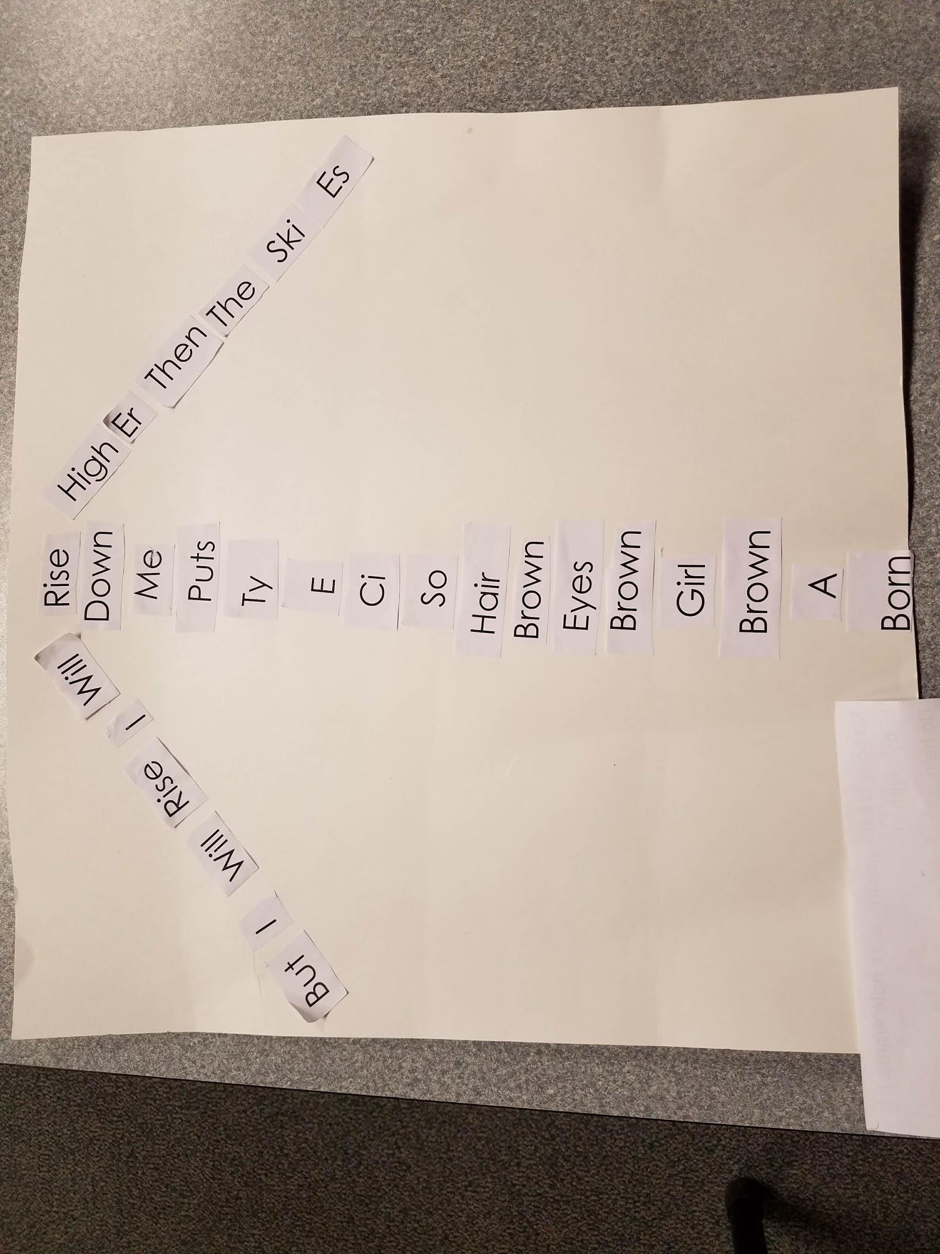
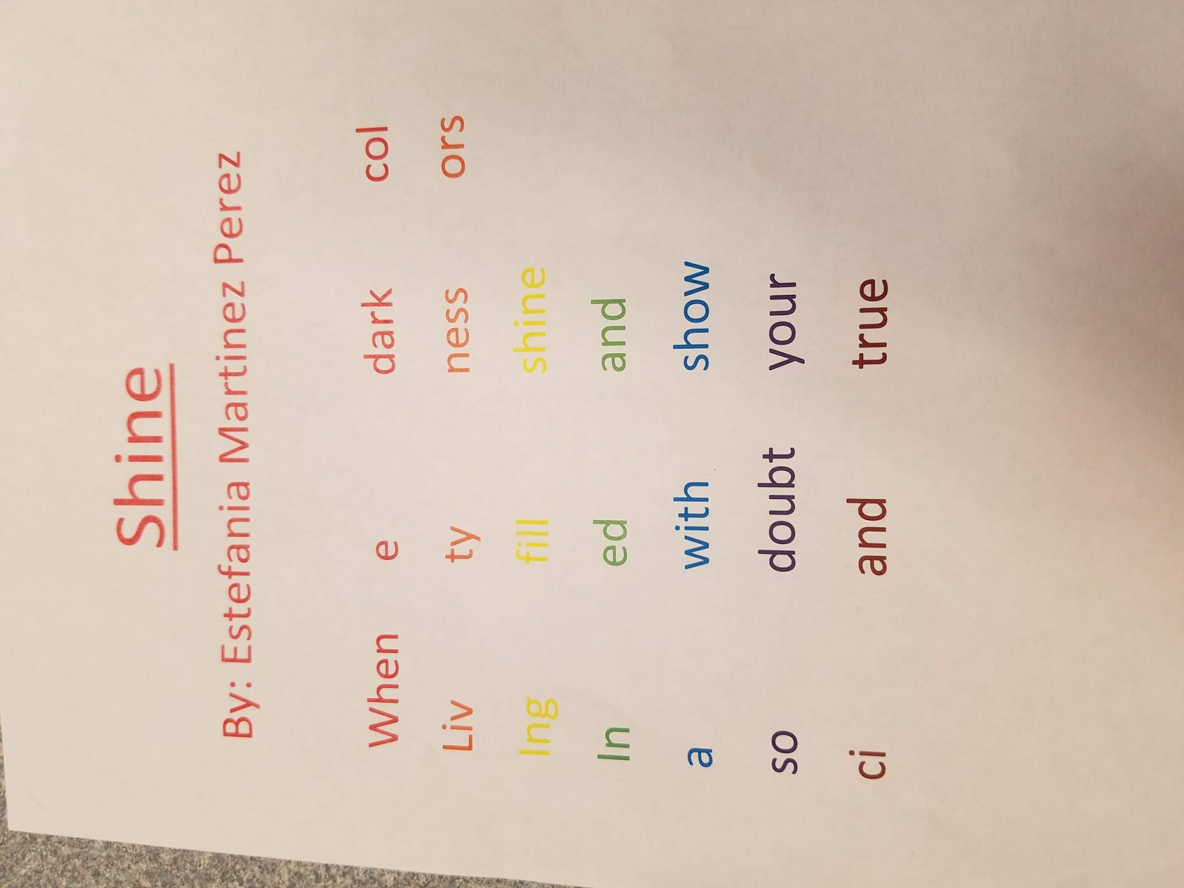
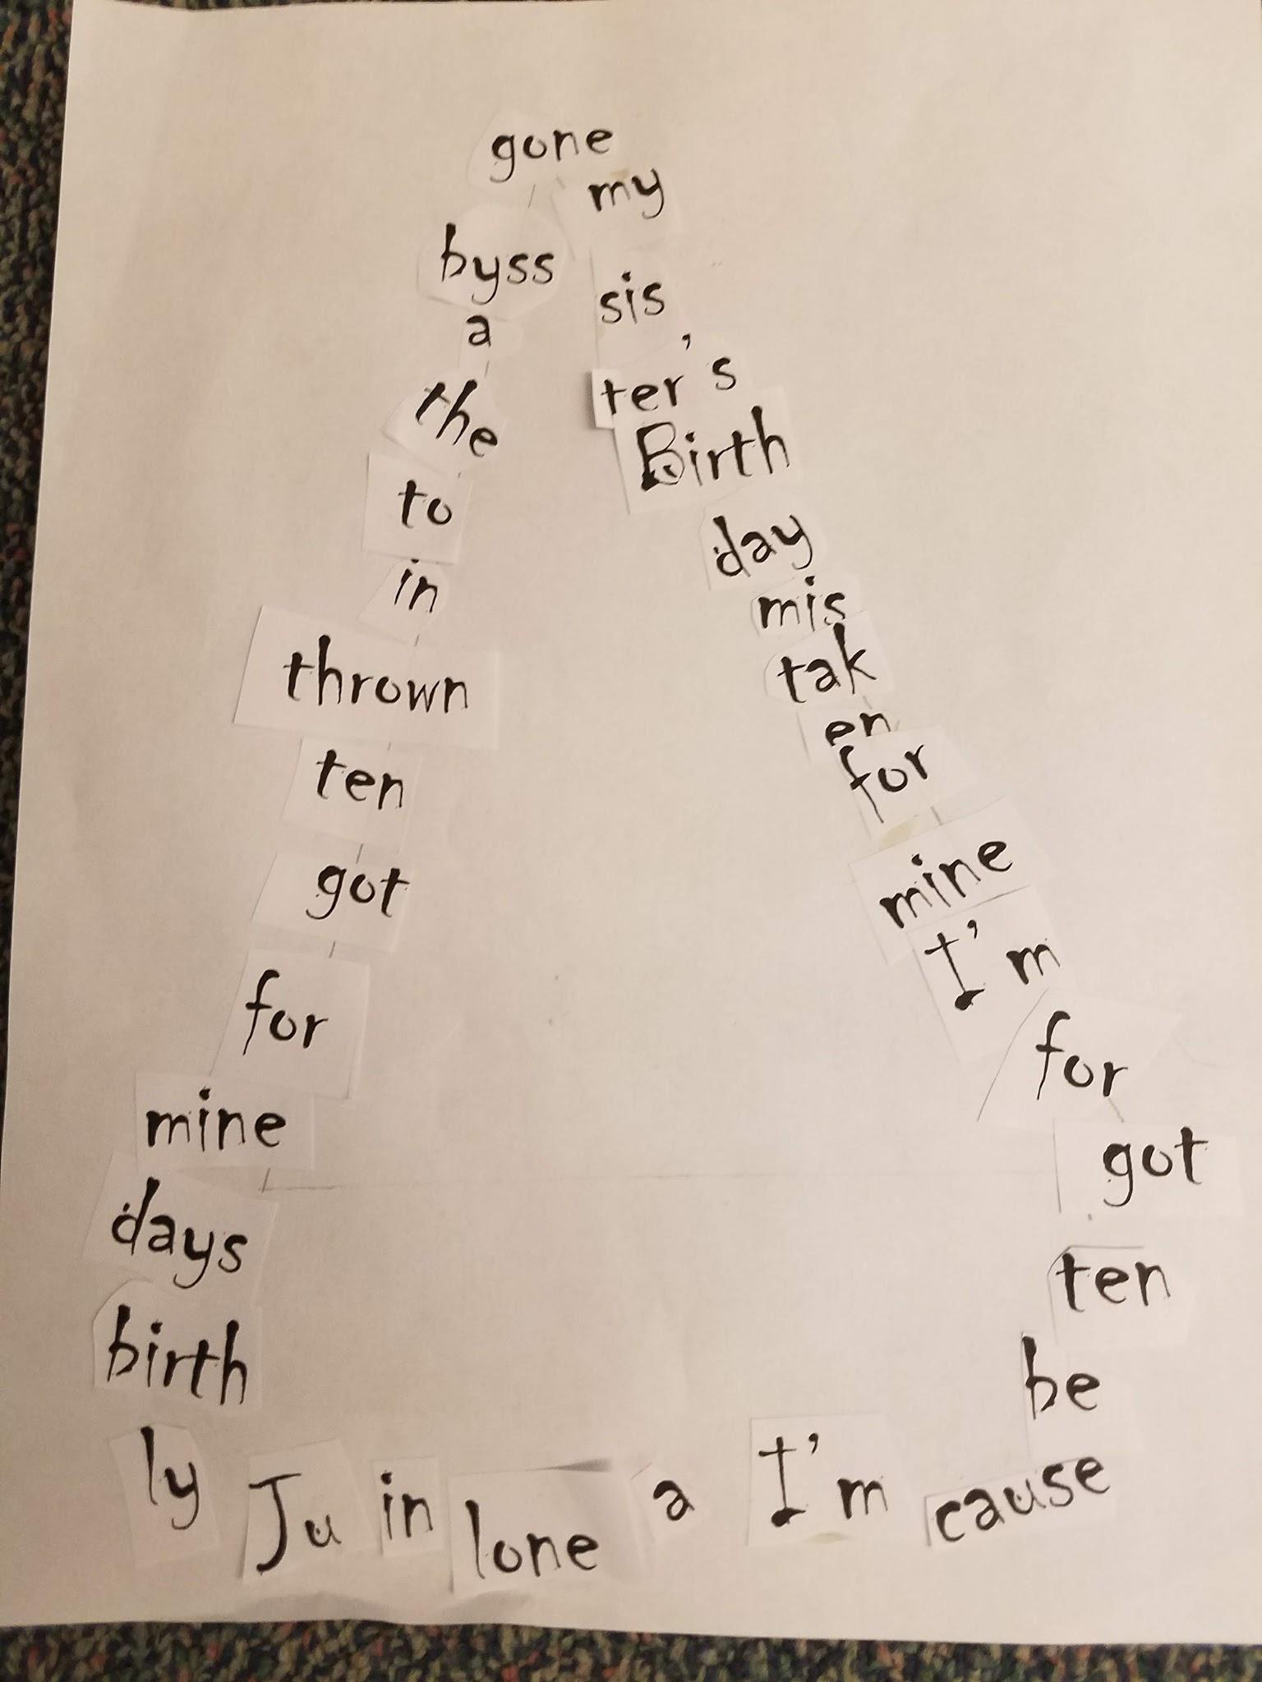
Poetry Assignment

Slide 23
Show them your imperfections

Slide 24
Sharing Wrong Answers

Slide 25
Share Your Strategies

Slide 26
In a Nutshell
Research shows that SEL not only improves achievement by an average of 11 percentile points, but it also increases prosocial behaviors (kindness, sharing, and empathy, etc.), improves student attitudes toward school, and reduces depression and stress among students (Durlak et al., 2011).

Slide 27
SEL For Teachers
To facilitate students’ social and emotional learning, a teacher must know the student as a person. This means that the teacher must strive to know her or him self. In order to help students achieve a degree of well-being, teachers need to be aware of their own well-being.
Notes:
Great summation To close us.

Slide 28
Session Review
In this session, our plan was to explore strategies for building student-teacher relationships. It was an opportunity to explore why student voice, and both teacher and student self-efficacy have a high effect on student achievement.
In a nutshell: We hoped this session would prepare teachers and administrators to head back to their building and look at class policies and make systemic changes that emphasize SEL for both teachers and students.

Slide 29
Thoughts?
Questions?

