Slide 1
The Intersection of Social-Emotional Learning and Equity
Presenter: Mary Fertakis, M.Ed.
CEO, M FERTAKIS Consulting, LLC
Consultant, National School Boards Association
mfertakisconsulting@gmail.com
YDECK Whole Child, Whole Day Symposium Friday, August 10, 2018

Slide 2
Learner Outcomes
Gain an understanding of the differences between Equity, Equality, Educational Equity, and SEL and Equity.
Gain an understanding of SEL Principles, ACE’s (Adverse Childhood Experiences), and Toxic Stress/Trauma issues.
Explore how SEL and Equity intersect.
Learn strategies to ensure SEL is a part of equitable policy, strategic plan, and resource allocation decisions.

Slide 3
Norms for Equity Discussions (adapted from Glenn Singleton’s Courageous Conversations About Race)
Speak Your Truth
Stay Engaged
Expect to Experience Discomfort at Some Level
Be Aware of Intent; Own Your Impact
Accept and Expect Non-Closure
Maintain a Learner Stance and Remain Open to New Thinking
Notes:
On the Intent vs. Impact norm: Refer to the Micro-Aggressions document.

Slide 4
ACTIVITY – Standing in Another’s Shoes
Directions:
Do NOT write your name on the sheet in front of you.
Respond to each of the questions by placing an “X” on the line next to any statement that applies to you.
Fold your paper in half when finished.
When directed, stand up, and pass the sheet of paper 5 times (to five different people)

Slide 5
What is Equity?
Equality
Equity
Educational Equity
Each person receives the SAME amount of resources, attention and supports.
Each person receives the amount they NEED in the
way of resources, attention and supports.
Every student has access to the resources and educational rigor they NEED at the right moment in their education, regardless of race, gender, ethnicity, language, ability, family background, or family income.

Slide 6
Equality vs. Equity (Graphic by Robert Wood Johnson Foundation)

Slide 7
What is Social-Emotional Learning? The Collaborative for Academic, Social and Emotional Learning (CASEL)
The process through which children and adults acquire and effectively apply the knowledge, attitudes, and skills necessary to:
Understand and Manage Emotions
Set and Achieve Positive Goals
Feel and Show Empathy for Others
Establish and Maintain Positive Relationships
Make Responsible Decisions

Slide 8
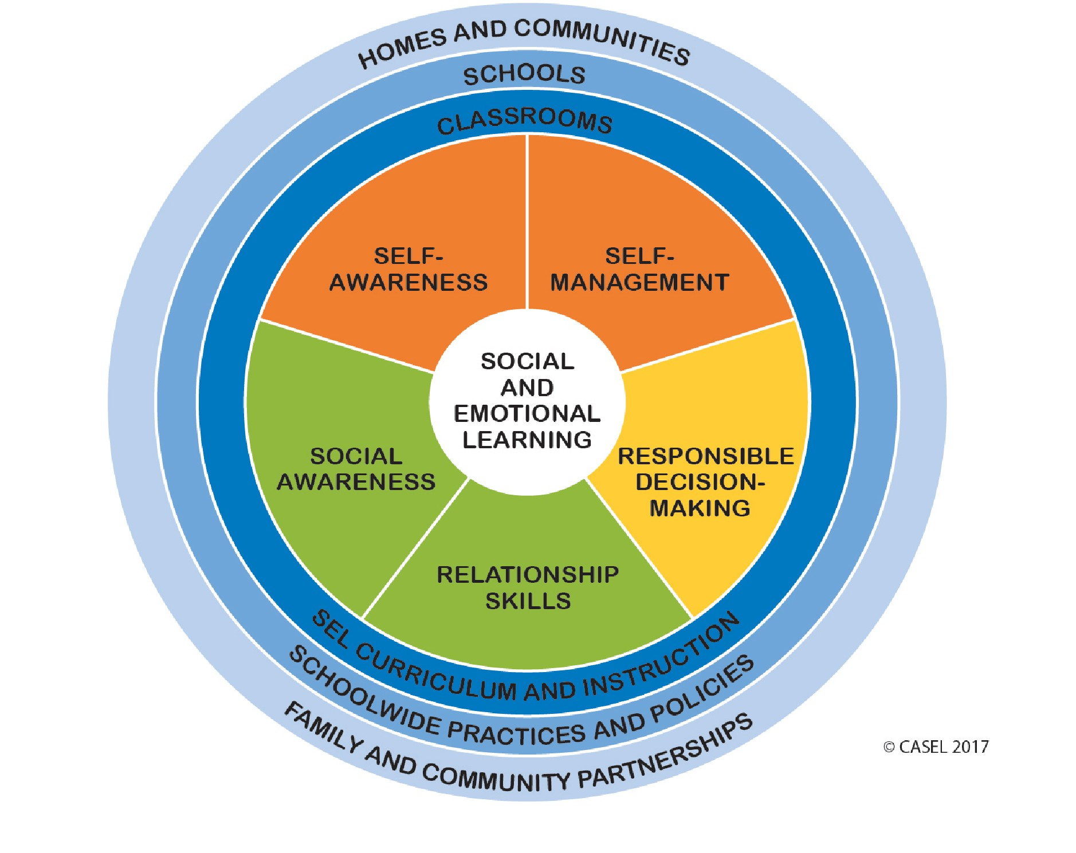
Researchers generally agree upon five key competencies of SEL (Durlak, Weissberg, Dymnicki, Taylor & Schellinger, 2011)

Slide 9
SEL Core Competencies: Self-Awareness
The ability to accurately recognize one’s own emotions, thoughts, and values and how they influence behavior. The ability to accurately assess one’s strengths and limitations, with a well-grounded sense of confidence, optimism, and a “growth mindset.”
Identifying emotions -> What are my thoughts & feelings?
Accurate self-perception -> What causes these thoughts & feelings?
Recognizing strengths -> How can I express my thoughts & feelings
Self-confidence respectfully?
Self-efficacy

Slide 10
SEL Core Competencies: Self-Management
The ability to successfully regulate one’s emotions, thoughts, and behaviors in different situations — effectively managing stress, controlling impulses, and motivating oneself. The ability to set and work toward personal and academic goals.
Impulse control -> What different responses can I have to an event?
Stress management -> How can I respond to an event as constructively
Self-discipline as possible?
Self-motivation -> How can I better understand other people’s
Goal-setting thoughts and feelings?
Organizational skills

Slide 11
SEL Core Competencies: Social Awareness
The ability to take the perspective of and empathize with others, including those from diverse backgrounds and cultures. The ability to understand social and ethical norms for behavior and to recognize family, school, and community resources and supports.
Perspective-taking -> How can I better understand why
Empathy people think & feel the way they do?
Appreciating diversity -> How can I adjust my actions so that my
Respect for others interactions with different people turn
out well?

Slide 12
SEL Core Competencies: Relationship Skills
The ability to establish and maintain healthy and rewarding relationships with diverse individuals and groups. The ability to communicate clearly, listen well, cooperate with others, resist inappropriate social pressure, negotiate conflict constructively, and seek and offer help when needed.
Communication -> How can I communicate my
Social engagement expectations to other people?
Relationship-building -> How can I communicate with other
Teamwork people to understand and manage
their expectations of me?

Slide 13
SEL Core Competencies: Responsible Decision-Making
The ability to make constructive choices about personal behavior and social interactions based on ethical standards, safety concerns, and social norms. The realistic evaluation of consequences of various actions, and a consideration of the well-being of oneself and others.
Identifying problems -> What consequences will my actions
Analyzing situations have on myself and others?
Solving problems -> How do my choices align with my
Evaluating values?
Reflecting -> How can I solve problems creatively?
Ethical responsibility

Slide 14
Benefits of SEL (The Aspen Institute – National Commission on Social, Emotional and Academic Development)
Improved attitudes and behaviors
Reduction in classroom and criminal misconduct, substance abuse, pregnancy, drop out rates, and mental health issues.
Better relationships with peers, families, and adults.
More time spent on teaching and learning; less time spent on classroom management.
Increased academic performance, graduation rates, postsecondary enrollment and completion, employment rates and average wages.

Slide 15
Using SEL Practices to Address Disproportionality
Federal CRDC (Civil Rights Data Center) data on US High School suspensions and expulsions (2013-14) show:
Black students are 16% of the K-12 population but represent 32-42% of suspended and expelled students, compared to White students, who are suspended and expelled at similar rates (31-40%) but represent 50% of the K-12 population.
On average, 4.6% of White students are suspended, nationally, compared to 16.4% of Black students - a rate 3x greater than White students.
In WA (2016-17), Black students are 4.4% of K-12 (9.5% suspended), Latinx students are 22.8% of K-12 (26% suspended) and White students are 56% of K-12 (49.8%) were suspended.

Slide 16
Using SEL Practices to Address Disproportionality
Federal CRDC data for pre-school suspensions (2013-14) show Black children as 19% of all pre-schoolers and accounting for 47% of total suspensions.
Children of color experience trauma at a higher rate than their White peers, and data show children in trauma have higher drop-out and incarceration rates.
In WA, Blacks are 3.98% of the overall population, yet represent 18.3% of incarcerated adults (2016)
In WA, Black youth are 4.4% of the K-12 population, yet represent 20% of incarcerated youth (2016)
In 6 states, African American youth are at least 10 times as likely to be held in placement as are white youth: NJ, WI, MT, DE, CT, and MA (2017)

Slide 17
Adverse Childhood Experiences (ACE’s)
Activity: Take the Assessment

Slide 18
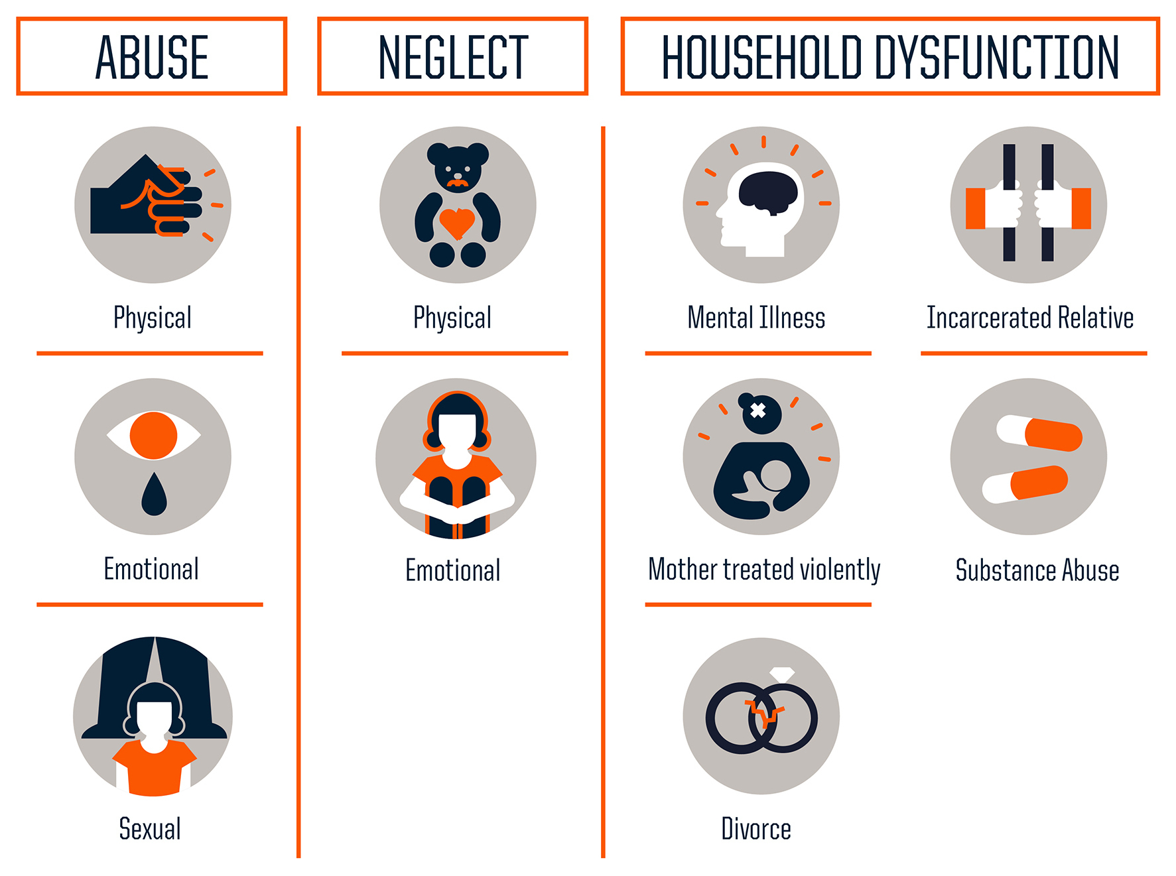
Three Types of Adverse Childhood Experiences (ACEs) (Source: Centers for Disease Control & Prevention; Graphic: Robert Wood Johnson Foundation)

Slide 19
ACE’s = Increased Health Risks (Source: Centers for Disease Control & Prevention; Graphic: Robert Wood Johnson Foundation)

Slide 21
Toxic Stress
Too much stress = toxic stress
(Occurs when a child is overloaded)

Slide 22
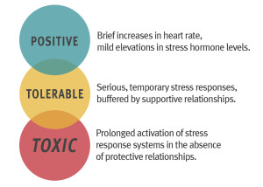

Slide 23
The Three Types of Stress Responses: Effects on the Body
Positive Stress Response
Tolerable Stress Response
Toxic Stress Response
Normal and essential part of healthy development.
Examples:
1) First day with a new caregiver
2) Receiving an immunization shot
Result of more severe, longer-lasting difficulties.
If time-limited and buffered by relationships, brain and other organs recover.
Examples:
1) Loss of a loved one
2) Experiencing a natural disaster
3) Frightening injury
Result of strong, frequent and/or prolonged adversity.
Can disrupt development of brain architecture and other organ systems.
Examples:
Chronic neglect
Physical/emotional abuse
Exposure to violence
Family economic hardship

Slide 24
Causes of Toxic Stress / Complex Trauma (S. Hanauer, D. Lewis, 2014)
Student Mobility
Emotional Abuse
Homelessness
Unemployment
Poor Nutrition/Hunger
Lack of Health Care
Chronic Medical Conditions
Witness to a Death or Violent Act
Physical and/or Emotional Neglect or Abandonment
Birth Defects
Bullying/Cyber-Bullying/Victimization
Anti-Social Peer Groups
Learning Disabilities
Experience of Racism
Poverty
History of Suicide in Family
Mental Health of Family Member
Incarcerated Parent
Teen Pregnancy
Multiple Changes in Caregivers
Loss of Parent due to Death or Divorce

Slide 25
Behaviors (Centers for Disease Control and Prevention [CDC], 2014)
Complex Trauma/Anxiety
Impulsive
Difficulty focusing
Anxious and fearful
Memory problems
Poor skill development
Act out in school situations
Act withdrawn
Develop learning disabilities
ADHD / ADD
Impulsive
Trouble staying focused
Easily distracted
Difficulty with memory
Difficulty following instructions
Trouble planning ahead and finishing projects

Slide 26
Affluent Student Toxic Stress (Excerpt from Teen Stress: Why Adults Should Be Concerned)
“Our youth are stressed to the max, which can lead to so many issues – anxiety, suicidal thoughts, depression, withdrawal. Much of the stress comes from academic pressures and expectations…from society, teachers, parents, media. From a young age, we have our children in extra tutoring, extra coaching, lessons for sports, extra testing to get into better programs, tutoring for testing, music lessons, etc…
Don’t buy into the notion that your child needs to be the best of the best at everything …that being stressed out, sleep-deprived and miserable is just a part of being a teenager…that your child won’t be successful without a 4.0 GPA, 200 hours of volunteer work, 15 AP classes, and five sports championships…
Encourage learning, failure and growth rather than expecting perfection. Ask about your child’s well-being before asking about their grades.”

Slide 27
Trauma-Informed Practices
“A trauma-informed approach asks:
‘What happened to you?’ instead of ‘What’s wrong with you?’
or ‘Help me better understand your experience.’”
~David Lewis MA., LMHC., Director/Program Manager Behavioral Health Services
Seattle Public Schools

Slide 28
What is Trauma?
Definition: A psychologically distressing event that is outside of the range of the usual human experience, often involving a sense of intense fear, terror and helplessness.
25-39% of children have experienced or witnessed a traumatic event.
Low-income and children of color are more likely to experience trauma due to their disproportionate exposure to poverty and violence.

Slide 29
Types of Trauma
Simple Trauma
One-time Victim of a Crime
Car Accident
House Fire
Earthquake
Physical Injury
Complex Trauma
Ongoing Physical/Emotional Abuse, Bullying, or Victimization
Emotional Neglect
Sexual Abuse
Domestic Violence
Familial Substance Abuse
Placement Disruptions (Foster Care)
Refugee Camp Experience
Chronic Homelessness
Culture Shock - Immigrants

Slide 30
Physiological Impact of Trauma on Children
Children with still-developing neural pathways associated with responses to danger, impulse control, and memory are adversely affected by trauma.
Trauma’s impact on the brain often places children in a state of hyper-arousal, causing them to over-react to situations that are otherwise non-threatening.
Adrenaline levels and heart rates of children living with trauma are higher than their less stressed peers.
Internal response: Lack of motivation; Depression; Declining class participation
External response: Outbursts; Violence; Defiance

Slide 31
Trauma-affected children are significantly different than their peers in these areas:
Concentration
Problem-solving
Abstract thinking
Working collaboratively in groups
Ability to recall facts
Working memory
Comprehension
Classroom and teacher transitions
Forming relationships
Regulating emotions
Organizing material sequentially
Application of knowledge

Slide 32
What are Trauma-Informed Practices?
A framework for understanding, recognizing and responding to the effects trauma can have on a person.
In a school setting, this means there is an understanding that disruptive or hostile behavior is derived from suffering/pain – not from anger.
The behavior does not occur by choice, but is driven by triggers such as a confrontation or change in routine/schedule.
Prioritizes treatment over punishment.
Does NOT mean the absence of discipline.
Focus is on building opportunities for students to succeed by helping them regulate their emotions, and create an environment where they feel safe, and connected to caring adults.
Examples of Practices/Programs:
Guided Meditation; Mindfulness; Collaborative Problem-Solving; Positive Behavioral Intervention and Supports (PBIS); being a “Warm Demander”

Slide 33
When Students Are Traumatized, Teachers Can Be Too
Vicarious Trauma – a secondary type of trauma, sometimes referred to as “the cost of caring”.
Can result from “hearing [people’s] trauma stories and becom[ing] witnesses to the pain, fear and terror that trauma survivors have endured.” (American Counseling Assn.).
Is a concern for teachers who work in high-needs settings and are directly exposed to a large number of young people who have/are experiencing trauma.
PD is important for school staff in these settings to learn how to navigate trauma.
* Resource: Trauma Smart (http://traumasmart.org) – partners with schools and early learning programs to help children and the adults in their lives navigate trauma)

Slide 34
The Intersection of Equity and SEL
“If we teach social-emotional learning in ways that ignore equity, we will woefully fail our students, particularly our most disenfranchised.”
~Dena Simmons, Yale Center for Emotional Intelligence

Slide 35
Intersection of Equity and SEL
Equity
Educational Equity
SEL and Equity
Every student receives the amount they NEED in the way of resources, attention and supports.
Every student has access to the resources and educational rigor they NEED at the right moment in their education, regardless of race, gender, ethnicity, language, ability, family background, or family income.
Every student receives what they NEED to develop to their full academic and social potential regardless of race, gender, ethnicity, language, ability, family background, or family income.

Slide 36
SEL, Equity, and Student Identity
How a student sees her/himself in the world impacts their school experience.
-> ACTIVITY: Becoming Joey (poem)
Culture, race, gender, class, sexual identity, language, etc.
Situatedness: How one is positioned relative to opportunity and access.
Identity with peers within school – integration or segregation?

Slide 37
SEL, Equity, and Student Mindset
What are a student’s beliefs about their own learning and capacity?
Do they have a sense of belonging in the academic community?
Do they believe that effort leads to increased ability?
Do they believe that success is possible?
Do they believe that the work has value (is it relevant)?

Slide 38
Students’ Sense of Belonging – Research Says…
When students sense their teachers respect them, trust increases and misbehavior decreases, resulting in lower suspension rates. (Stanford researchers Okonofua, Paunesku & Walton, 2016)
Students whose teachers received PD in the importance of empathy in the classroom were half as likely to be suspended by the end of the school year.
Stronger effects were noted for Black and Latino boys who had been suspended the prior year.
Middle school students who perceive inconsistent treatment for their racial or ethnic group have lower levels of trust for teachers and school officials. (UT-Austin, Columbia & Stanford research project results - “Child Development”, 2017)
Lack of trust in school correlated to higher discipline rates and a lower likelihood of later enrollment in a 4-year university.

Slide 39
Student’s Sense of Belonging – Research Says…
Students from under-represented groups, or who are part of a group that is subject to negative stereotypes may respond differently to failure or criticism from a teacher. (Bondy, Ross, Gallingane & Hambacker - Urban Education, 2007)
Students view such experiences as confirmation that they are less capable than their peers.
Teachers as “Warm Demanders” (“Expect a great deal from their students, convince them of their own brilliance, and help them reach their potential in a disciplined & structured environment.” – Lisa Delpit, author of Other People’s Children).
Students from cultural backgrounds that emphasize inter-dependence and community may struggle in schools that view success as an individual endeavor. (Northwestern, UW, Stanford study, 2012)
First generation college students performed better academically after participating in an exercise that emphasized the value of community.

Slide 40
Developing an Equity Lens for SEL Instruction: Suggestions from a Teacher of Color
Flex your self-awareness muscles to understand your power, privilege and unconscious bias if you come from a different background than your students.
Take the Harvard Implicit Bias Test; read Blindspot: The Hidden Biases of Good People
Read Peggy McIntosh’s “Unpacking the Invisible Knapsack”
Make SEL meaningful and relevant for students.
Don’t impose on students of color one set of values and beliefs about behavior, conflict resolution, relationship-building and decision-making (most curricula in the US come from a White, Western, and individualistic perspective).
Sends a message to students that they are inferior for being who they are.
Allow students space to learn how to navigate the differences between home and school.
Teach “code switching” (altering speech or behavior depending on a given context).

Slide 41
Developing an Equity Lens for SEL Instruction: Suggestions from a Teacher of Color
Build relationships with students, their families and their community
Students: Feel more connected to school (a preventative factor against risky behaviors) and increases their likelihood of academic success; survey them to find out about their hobbies, home lives, academic strengths, areas for growth, social circles, favorite foods, etc.
Families: Establish communication norms to avoid misunderstandings; ask how you can partner together; translate materials.
Community: Conduct an asset-mapping inventory of religious, political, economic, social service and health institutions, as well as identifying who the leaders are in different communities to provide community context.

Slide 42
Equity Questions for SEL Programs & Instruction
Is your SEL program/curriculum being taught in a culturally responsive context?
Does it incorporate and value students’ diverse life experiences?
Does it allow for variations in responses or is one set of cultural norms elevated?
Are students being positioned as the problem, rather than the teacher’s implicit bias/stereotype of groups of children?
Has SEL been introduced into your buildings without changing the curricula, behaviors, and policies that have institutionalized current inequities?
Have staff (not just teachers) received SEL principles and trauma-informed Professional Development?

Slide 43
Measuring SEL – What is the Purpose? (from Measuring SEL: A Brief Guide by Education Northwest)
Identification of Student Need
Trauma-Informed Approach (Front end: Intervene early, before problems arise)
Early Warning Systems (Back-end: Intervene once problems have been detected)
Program Improvement
Priority Setting (Front end: Focus efforts based on students’ current status)
Assessing Change (Back end: Were efforts effective and successful?)
Accountability
Identify schools, districts or programs in need of additional support
SEL measures must be reliable at the setting/program level
When tied to high-stakes decisions, there is a potential for gaming the measures

Slide 44
Measuring SEL- What to Measure and How? (from Measuring SEL: A Brief Guide by Education Northwest)
What To Measure?
Areas that have the potential to impact long-term outcomes for students
Areas that align with local priorities and goals (what we care about)
Areas that are within our power to change
Areas that are aligned with existing capacities (structures/resources currently in place to support students and/or inform instruction and programming)
What Tool(s) to Use?
Survey students or adults? (students may be the best judge of their internal beliefs and mindset; adults who work with them may be better judges of their outward behavior)
Does the tool provide accurate, timely information for explicit action(s) to be taken?
How rigorous does it need to be? Is the data intended for internal information gathering or high-stakes decision-making?
Is it practical? (cost; training; is additional technology needed?; how much time is required to participate?)

Slide 45
APPLICATION of CONTENT

Slide 46
Best Practice Example
Note on the first draft of a student essay:
“I’m giving you these comments because I have very high expectations and I know that you can reach them.”
VS.
“I’m giving you these comments so you’ll have feedback on your paper.”
Students were more likely to revise their essay when receiving the first note than the control group that received the second note.
The effects were stronger for Black students than other sub-groups.

Slide 47
Best Practice Example
2) Introduction to a Math assignment:
“Now this is a tough assignment. In the past, a lot of students have had trouble with it. They came in to ask me questions and I told them they had to figure it out on their own.”
VS.
“This next assignment is really tough. You might struggle with it, but I know you can handle it on your own. You might have questions but I’d like you to try and work it out for yourselves. If you get stuck though, you can come talk to me.”
#2 bolsters students’ confidence and growth mindset, rather than setting them up for anxiety.
When students feel their teachers care, they put forth more effort in that class.

Slide 48
Summary
“When we develop SEL skills, our ability to form relationships and build social awareness increases, enhancing our ability to connect with individuals of diverse perspectives, cultures, languages, histories, identities and abilities.
By implementing SEL on a macro-level, we create more equitable, better-performing schools and communities. This type of cultural change creates environments in which all students learn the skills needed to be prepared for career, college, and life.”
(Addressing Social Emotional Learning in Washington’s K-12 Public Schools, 2016)

Slide 49
RESOURCES:
Whistling Vivaldi (Claude Steele)
Culturally Responsive Teaching and the Brain (Zaretta Hammond)
Despite the Best Intentions: How Racial Inequality Thrives in Good Schools (A. Lewis & J. Diamond)
Blindspot: Hidden Biases of Good People (Mahzarin R. Banaji & Anthony G. Greenwald)
Why We Drop Out: Understanding and Disrupting Pathways to Leaving School (Deborah Feldman, Antony Smith, Barbara Waxman)
Fostering Resilient Learners: Strategies for Creating a Trauma-Sensitive Classroom (Kristin Souers & Pete Hall)
Starting Small: Teaching Tolerance in Pre-School and the Early Grades (The Teaching Tolerance Project, Southern Poverty Law Center - forward by Vivian Gussin Paley NOTE: Extensive book list included at the end)

Slide 50
RESOURCES:
The Collaborative for Academic, Social & Emotional Learning (CASEL): http://casel.org/why-it-matters/what-is-sel/skills.competencies
Economic Benefits of SEL: https://www.edutopia.org/resource/econ-value-sel-research
Integrating SEL with College/Career Readiness Standards: https://www.aspeninstitute.org/publications/this-time-with-feeling/
American School Board Journal: https://www.nsba.org/newsroom/american-school-board-journal/asbj-june-2017/database-sad-not-bad
Trauma-Informed Training: http://www.sounddiscipline.org/
Education Week – “Is SEL Really Going to Work for Students of Color?” (article): http://mobile.edweek.org/c.jsp?cid=25919701&bcid=25919701&rssid=25919691&item=http%3A%2F%2Fapi.edweek.org%2Fv1%2Ftm%2F%3Fuuid%3DEC0C1CB0-46D8-11E7-BBA9-D5FAB3743667

Slide 51
RESOURCES:
Teen Stress: https://eastsideedu.com/teen-stress-adults-concerned/
Harvard Center for the Developing Child – Toxic Stress: http://developingchild.harvard.edu/science/key-concepts/toxic-stress/
“What steps can we take to get started on the journey to become a trauma-sensitive safe and supportive school?”: http://traumasensitiveschools.org/author/tlpi-team/
ACE’s Quiz and Article – What it Does and Doesn’t Mean: http://www.npr.org/sections/health-shots/2015/03/02/387007941/take-the-ace-quiz-and-learn-what-it-does-and-doesnt-mean
Finding What’s Right With Children Who Grow Up in High Stress Environments: https://unews.utah.edu/high-stress-environments/
Students’ Sense of Belonging: http://www.edweek.org/ew/articles/2017/06/21/belonging-at-school-starts-with-teachers.html

Slide 52
RESOURCES:
Harvard Implicit Bias Test: https://implicit.harvard.edu/implicit/takeatest.html
Peggy McIntosh – “Unpacking the Invisible Knapsack”: https://www.deanza.edu/faculty/lewisjulie/White%20Priviledge%20Unpacking%20the%20Invisible%20Knapsack.pdf
Robert Jensen – “The Fears of White People”: http://www.mccc.edu/pdf/cmn214/Class%208/The%20fears%20of%20white%20people.pdf
Damali Ayo – “I Can Fix It!: http://www.damaliayo.com/pdfs/I%20CAN%20FIX%20IT_racism.pdf
Addressing Social-Emotional Learning in Washington’s K-12 Public Schools (report):http://www.k12.wa.us/Workgroups/SELBMeetings/SELBWorkgroup2016Report.pdf

Slide 53
RESOURCES:
Suspension Data by Race: http://files.eric.ed.gov/fulltext/ED537954.pdf
When Students Are Traumatized, Teachers Can Be Too: http://www.edutopia.org/article/when-students-are-traumatized-teachers-are-too
The Sentencing Project: http://www.sentencingproject.org/wp-content/uploads/2016/01/Uneven-Justice-State-Rates-of-Incarceration-by-Race-and-Ethnicity.pdf
US Department of Education, Civil Rights Data Center: https://ocrdata.ed.gov/downloads/projections/2013-14/One-out-of-school-suspension.xlsx
The Warm Demander – An Equity Approach: https://www.edutopia.org/blog/warm-demander-equity-approach-matt-alexander
The Teacher as Warm Demander: http://www.sjsu.edu/faculty/marachi/mle/Warm%20Demander%20Article.pdf

Slide 54
Thank you for attending this session!
Mary Fertakis, M.Ed.
M FERTAKIS Consulting, LLC
mfertakisconsulting@gmail.com

