Slide 1
Trauma-Informed Somatic-Based Tools for Youth
Whole Child, Whole Day 2018
Alyssa Pizarro + Rosa Vissers Yoga Behind Bars

Slide 2
Notes:
Welcome! Introduction of ourselves: Name, title, pronouns, race, teaching background
ORIENTING: Check who is in the room: educators, yogis?

Slide 3
Notes:
Before we continue GROUNDING/ CENTERING:
RV Acknowledge Native land. Meditation acknowledging people who are supporting us now, supporting us in the past, including people we don’t know, then next generation. With choices.
I acknowledge, with humility, that we are meeting, working, and living on the land of the Duwamish, Muckleshoot, and other tribes. My presence here is inextricably linked to forced removal, violent assimilation, and genocide of indigenous peoples.

Slide 4
WHAT WE’LL TALK ABOUT
Yoga Behind Bars: mission, vision, the work
Practical, body-based tools to offer students and yourself
Movement, Breathing, and Mindfulness exercises
Self-care
Q&A
Notes:
AP Presentation grounded in actual hands on experience of our work with YBB and scientific research
We will be weaving practical exercises throughout our presentation. You always have choices and agency to opt out.
We will be talking about trauma.
We are focusing on the tools and not on the RSJ analysis of our work, because it is our hope that people will get that in other sessions
RV
You’ll see we brought sticky notes for questions And fidget toys, please use, and please RETURN

Slide 5
OUR MISSION
Yoga Behind Bars shares
trauma-informed yoga and meditation with people involved in the criminal justice system to promote rehabilitation, personal transformation, and a more just society for all.
Notes:
AP
YBB is the only nonprofit organization in Washington State dedicated to bringing yoga and meditation to prisons, jails, and detention centers. National leader.
Starting in 2008, with one teacher in Seattle’s downtown jail, today a team of 80+ instructors teach 35classes a week in 18 facilities across Washington state. Expanded to our 18th facility in 2017. Also have 9 incarcerated teachers teaching weekly. Currently have of our classes are for youth. We are proud to be training incarcerated women and men to be yoga teachers.
North Star: Prison populations drop, prisons and communities are able to recognize and leverage the humanity, potential, and capabilities of incarcerated and previously incarcerated individuals
This means we work within the criminal justice system. A system that is broken and racist and oppressive, yet it exists, and real people are caught up in it every day. Have to approach the issue of mass incarceration from all angles.

Slide 6
We teach + train + advocate
We offer trauma-informed yoga and meditation classes for incarcerated youth and adults.
We train people to work with populations impacted by trauma.
We build bridges through public education and advocacy
We are part of a larger movement to reform the criminal justice system in the United States.
Notes:
RV
In our programs in prisons and jails we focus on offering practical, accessible practices and methods to nurture resilience, balance, and inner peace.
We teach at all custody levels—maximum, medium, and minimum, as well as solitary confinement.
We teach all incarcerated populations—men, women, and youth.
Programs for veterans, seniors, men in solitary confinement, mental health units, DOSA Drug Offense Sentencing Alternative
Because we work both in jail and prison we work both with people who are behind bars short and long-term.
We offer a comprehensive 17-hour training program in trauma-informed yoga and movement modalities to address the unique challenges faced by populations impacted by trauma, especially incarcerated people.
500+ people have completed our training since 2008.
We were one of the first programs in the nation to offer a Yoga Teacher Training Behind Bars for prisoners.
Our work is not about yoga poses. We open doors to self-understanding, resilience, and transformation.
We build bridges through public education
Commitment to breaking the cycle of repeated incarceration
Center our students’ voices
In our programs in the community we focus on public education, advocacy, and dismantling oppressive systems, especially within the yoga community. We do this work in partnership with the community and other leaders.
We advocate for restorative justice solutions, holistic re-entry services, and the removal of other barriers that prevent formerly incarcerated people to rebuild their lives upon release.
Taking care of people caught in the system. Work towards radically transforming it at the same time.
18,000 people in WA State behind bars. 97% return to communities. No parole, no education, lack of opportunities. Barriers when they return. Support legislation.
Movie screenings and conversations, yoga and social justice in our training, committed to cultivating leaders behnd bars because our students are the ones to truly transform the system.

Slide 7
Challenges we face
YBB struggle with representation and larger yoga container that we are in
Gatekeeping
Funding
Notes:
RV + AP + RV
1.) giving partial and full­ride scholarships to our trauma­informed trainings for POC 2.) creating a teaching assistant role for yoga practitioners who have not been through a 200 hour training (which due to cost, location and cultural accessibility are primarily attended by white, able­bodied, cis­gendered women).

Slide 8
Notes:
AP Sun breaths exercise?

Slide 9
TRAUMA, WHAT IS IT?
SHOCK TRAUMA
CUMULATIVE TRAUMA
HISTORICAL TRAUMA
IN THE BODY, NOT JUST IN THE MIND BODY BECOMES UNSAFE
Physical
Social
Psychological
Notes:
RV Your body becomes the enemy INDIVIDUAL and COMMUNITY LEVELS
Human created or Forces of Nature
EVENT that is EXPERIENCED that has lasting EFFECTS
A traumatic event is an event which is overwhelming to a person physically or emotionally. On a broad level, trauma is anything from one’s life experience that remains trapped and unresolved, causing disturbances at the biological, physiological, emotional, mental or behavioral levels.
There are different kinds of trauma
Shock Trauma: accident, rape or natural disaster. Immediately after the event, shock and denial are typical. Longer term reactions include unpredictable emotions, flashbacks, strained relationships and even physical symptoms like headaches or nausea. While these feelings are normal, some people have difficulty moving on with their lives.
Cumulative Trauma: Traumatized over a period of time within specific settings and scenarios. Such as child abuse, domestic violence, warzone, or prison, horrible boss
People everywhere experience trauma, but certain environments have a higher concentration of folks affected by traumatic events or circumstances. Prisons: high risk. Although the circumstances surrounding traumatic events may vary, the impact on the nervous system is the same. It is very important to understand the history and context of a community or individual that you are working with, as social norms, communication, self-expression and identity will vary. When working with traumatic symptoms, our sensitivity to these different dynamics are just as important as an understanding of the physiology of trauma.
Although many people who experience a traumatic event will go on with their lives without lasting negative effects, others will have more difficulty and experience traumatic stress reactions. Emerging research has documented the relationships among exposure to traumatic events, impaired neurodevelopmental and immune systems responses and subsequent health risk behaviors resulting in chronic physical or behavioral health disorders.

Slide 10
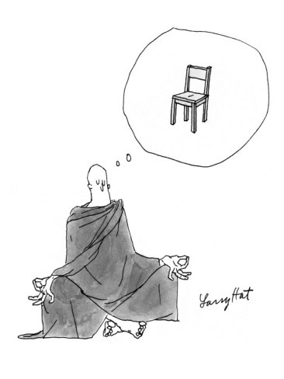
What is trauma-informed?
“A program, organization, or system that is trauma-informed realizes the widespread impact of trauma and understands potential paths for healing; recognizes the signs and symptoms of trauma in staff, clients, and others involved with the system; and responds by fully integrating knowledge about trauma into policies, procedures, practices, and settings.” SAHMSA, 2012 (Substance Abuse and Mental Health Services Administration)
Notes:
AP
Trauma-Informed, Trauma-Sensitivity, are these the right words for the work we are doing?
Trauma informed is really a lens or series of behaviors. Like to reframe and focus on the outcome: resiliency, strength, brilliance. Without bypassing. Getting the instructor to tolerate choicemaking by the students.
Make link to healing centered-engagement

Slide 11
We define trauma-informed yoga as offering embodiment practices that encourage participants to (re)claim their agency through nervous-system regulation.
Notes:
AP This is done through a social justice framework

Slide 12
WHY TRAUMA INFORMED YOGA
Trauma is everywhere
Inclusivity and Accessibility for our students
People of Color, people living in poverty, people living with disability, and other marginalized groups are more likely to be impacted by trauma
Trauma survivors can be re-traumatized by well-meaning helpers if we do not recognize and respond to the signs and symptoms of trauma
Notes:
RV
We do not know what people are carrying. Let’s not “other” people with trauma. BANDAID. How do we get to systemic change?
Impact of trauma more felt by POC, cash poor, unhoused, immigrants, LGBTQIA, people with disability
SAFE vs BRAVE Space. We can’t guarantee 100% safety, but we can try.
When trauma goes unrecognized, it can be difficult to understand students’ behaviors or attitudes

Slide 13
School to Prison Pipeline
Students of color face harsher discipline and are more likely to be pushed out of school than whites.
40% of students expelled from U.S. schools every year are Black.
70% of students involved in “in-school” arrests or referred to law enforcement are Black or Latino.
13% of Native boys and 7% of Native girls received out of school suspensions in 2012
68% of all males in state and federal prison do not have a high school diploma. – Community Coalition
Notes:
AP
Relevant to this audience. Not try to focus on people being broken, and not reinforce stereotypes.
INTENT OVER IMPACT
Who are our nation’s teachers?
Black students are 3.5x more likely to be suspended than whites.
Black and Latino students are 2x as likely to NOT graduate high school as whites.
Native youth 1.5x more likely to be incarcerated and sentenced as adults.
American Indian/Alaska Native youth are 50 percent more likely than whites to receive the most punitive measures.

Slide 14
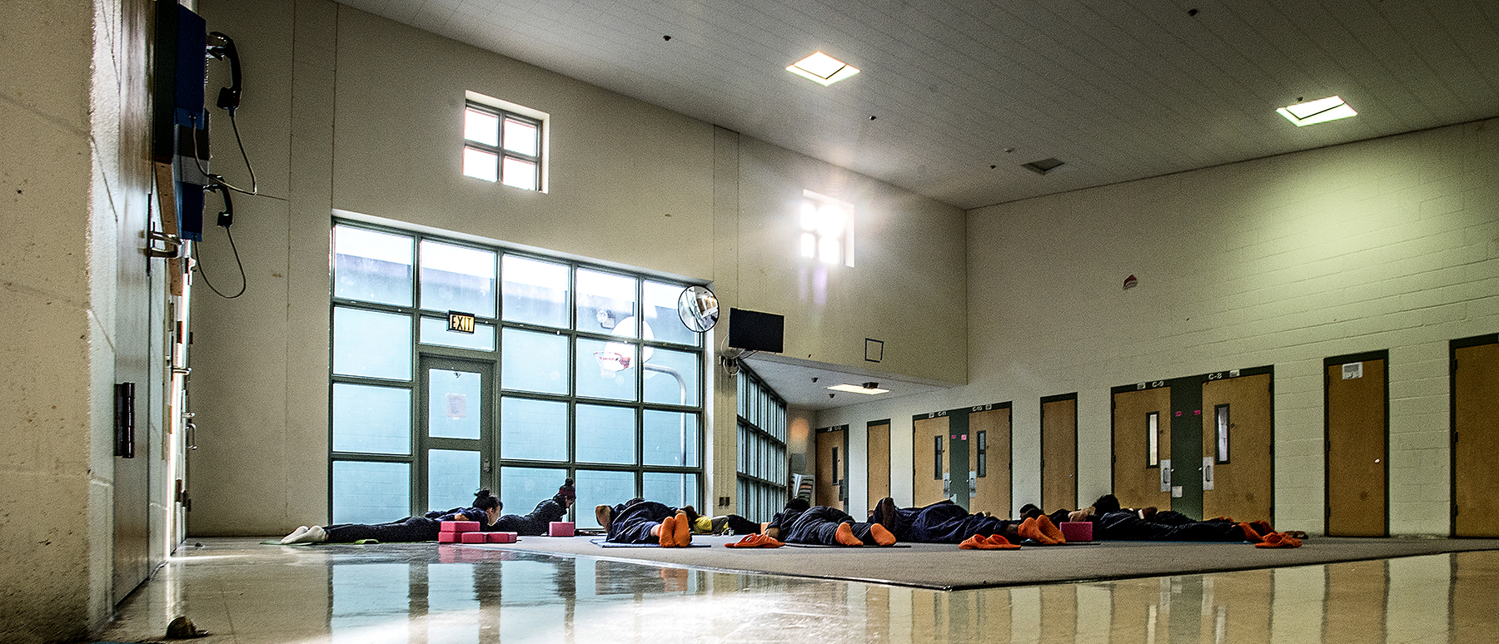
Regulating the Nervous System with Movement
Notes:
RV
FEEL YOUR FEET ON THE FLOOR. TAKE A BREATH IN THRU NOSE AND OUT THRU MOUTH.
One of the KEYS to get IN. Bottom Up Approach rather than Top Down. All you need is your body, no extra things needed.
Using our body and giving people tools before trauma happens makes them more resilient when something traumatic occurs. Reading bodies cues, feeling the breath, most of our students have been cut off from or never been shown how to do this.

Slide 15
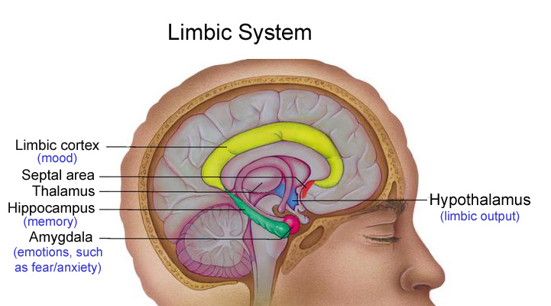
Notes:
RV
Give a quick overview and visit some concepts on the brain and nervous system.
Open and closed fist example. When fist opens, we don’t have access to higher brain/neo-cortex
Smoke detector. Right now your nervous system is working.
Tend Befriend
Sympathetic Nervous System: Action, Fight or Flight - Parasympathetic Nervous System: Rest & Digest
Freeze- submit
When we perceive or experience a threat, one of three things happens:
Try to solve issue through social connection.
Run to safety or fight off the danger. Running or fighting discharges the energy through physical exertion. and once you’re safe again, your body returns to homeostasis as the parasympathetic nervous system takes over, producing dopamine and serotonin. You might be a little shaken up, but over time, your body calms and you can relax.
What if the danger is inescapable? FREEZE or SUBMIT response. Once the danger has passed, the nervous system still needs to discharge all the activation that has built up. Animals in the wild will shake for a few minutes when this happens. Then they walk off on their merry way feeling fine. Humans will often override this natural instinctive response to shake because it scares them. Instead they will try and forget about the event. But the body remembers, and until all that activation is discharged, the nervous system can remain dysregulated.
SHAKE/ROCK body exercise. Push hands away from body exercise.
Sympathetic nervous system response is not bad. We need it.
We are living with incredible amounts of toxic stress, especially marginalized groups.
What happens when our nervous system is overloaded by trauma?
HOW DOES THIS SHOW UP IN YOUR WORK?

Slide 16
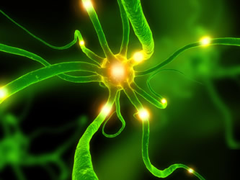
Three Neural Circuits Polyvagal Theory
Tend and Befriend: Myeliniated (vegetative) vagus: modulating calm bodily states and social engagement
Fight or Flight: Sympathetic-Adrenal system: mobilization strategies
Freeze – Surrender continuum: Primitive unmyelinated vagus: conservation of metabolic resources (immobilization, dissociation)
Notes:
RV
SUMMARY of BRAIN STUFF
Polyvagal theory. Building on the original binary model of parasympathetic. Now there are three layers.
primitive, unmyelinated vagus related to conservation of metabolic resources, to a sympathetic-adrenal system involved in mobilization strategies, to a myelinated vagus related to modulating calm bodily states and social engagement behaviors.
One circuit may override another. We usually react with our newest system, and if that doesn't work, we try an older one, then the oldest.
The theory is that the system reacts to real world challenges in a hierarchical manner, and not in a balanced manner. It is no longer just a sympathetic/parasympathetic system in balance. It's actually a hierarchical system. The hierarchy emphasizes that the newer "circuits" inhibit the older ones. We use the newest circuit to promote calm states, to self-soothe and to engage. When this doesn't work, we use the sympathetic-adrenal system to mobilize for fight and flight behaviors. And when that doesn't work, we use a very old vagal system, the freeze or shutdown system. So the theory states that our physiological responses are hierarchically organized in the way we react to challenge, and the hierarchy of reactions follows the sequence in which the systems evolved. Additionally, the linkage between the nerves that regulate the face and the nerves that regulate the heart and lungs implies that we can use the facial muscles to calm us down. Think about it: when we're stressed or anxious, we use our facial muscles, which include the ears. We eat or drink, we listen to music, and we talk to people to calm down.

Slide 17
Effects of trauma
Speech center shuts down ”This is why talk therapy is limited in helping someone recover from or heal from overwhelming stress.”
Impaired ability to assess threats, hypervigiliance
Impaired memory and difficulty processing information
Present moment awareness decreases
Feelings of numbness and disassociation or a hyperaroused state
Notes:
AP
physically, socially, psychologically. Compromised immune system. Substance Abuse. Depression and PTSD. Results in Heart Disease. Breakdown in Community. Social Isolation – Lack of Self Worth
Childhood abuse and other extreme stressors can have lasting effects on brain areas involved in memory and emotion. The hippocampus is a brain area involved in learning and memory that is particularly sensitive to stress.
Scans show that the part of the brain responsible for experiencing what happens in the present moment—the medial prefrontal cortex—shuts down during stress. (On the other hand, Moore cites research conducted at Harvard on mindfulness meditation, where the medial prefrontal cortex lights up.)
Many people turn to medication, drugs, food, and alcohol to deal with these states of being. But, of course, these external substances don’t address the root cause.
THIS IS WHERE YOGA COMES IN OR WHATEVER YOU WANT TO CALL IT

Slide 18
Benefits of Trauma-Informed Yoga
Trauma recovery
Physical benefits and improved overall well-being through nervous system regulation
Connection to resilience, choice making, present moment awareness
Developing stronger connection with self, feelings, emotions, boundaries
Effective adjunctive therapy during treatment for drug addiction
Recognition of human potential and shared humanity
Community
Notes:
AP
Trauma-Informed yoga is helpful for everyday life. “Trauma is a condition under which your body continues to get triggered into living an old situation as if you were back there again,”” explains van der Kolk, who has worked with many types of trauma patients.
Trauma is in the body. Traumatic experiences primarily impact the lower brain. Unresolved trauma has to do with an incomplete fight/flight response that can become the source of dysregulation or over-activation of the nervous system (see Figure 2). The limbic and reptilian parts of the brain rule the body and its processes. So if we try to use the neo-cortex, or rational part of the brain, to address trauma, we miss the mark. All three parts of the brain need to be addressed to heal trauma. This is why yoga and mind-body practices are so powerful is addressing the suffering that trauma can cause.
When people experience trauma, often there has been a boundary violation. Yoga makes our nervous system more efficient. Self regulate.

Slide 19
Tools for Wholeness + health
Notes:
IN THE BROADEST SENSE

Slide 20
Inviting Felt Sense: Tools for wholeness and resilience
Orienting
Grounding
Centering (in the body and in the present moment)
Alternating effort/rest
Take an even, steady breath…
Through your nose or mouth
Belly breathing
Even out inhalation and exhalation
Notes:
AP WALK PEOPLE THROUGH IT
As an instructor, use facial expression, intonation, hand gestures, to show what “regulation” looks like.
“Feel your feet on the floor” “Notice the strength in your legs” “Feel your sit bones (shins/ butt) on the floor” “Imagine roots going into the earth”
“What does that feel like in your body?” “Where do you feel the stretch?” “Notice your sensations- look for things that are tight, tingling, hot/ cold”

Slide 21
THE BASICS
Present Moment
Choice
Non-hierarchical language
Invitational
Students are in charge of their own experience
Normalize modifications and variations
Holding space for your students’ experience (non-judgmental, non shaming)
Predictability—e.g. how many repetitions, forecast length of exercises, rhythms
Notes:
RV
"Why aren't you smiling?" or "Try to listen better" or "Look in my eyes," when these behaviors are absent. Often treatment programs attempt to teach clients to make eye contact. But teaching someone to make eye contact is often virtually impossible when the individual has a disorder, such as autism or bipolar disorder, because the neural system controlling spontaneous eye gaze is turned off.
It's not related to a cognitive process. It's a physiological reaction that involves the nervous system. It's not a conscious reaction; most people who feel that way would rather not feel that way. They just can't turn it off. We have to understand that these feelings are physiological events, triggered by specific neural circuits, and we need to figure out how to recruit the neural circuits that promote social behavior.
Social behavior can be used to calm people down and to support health, growth and restoration.

Slide 22
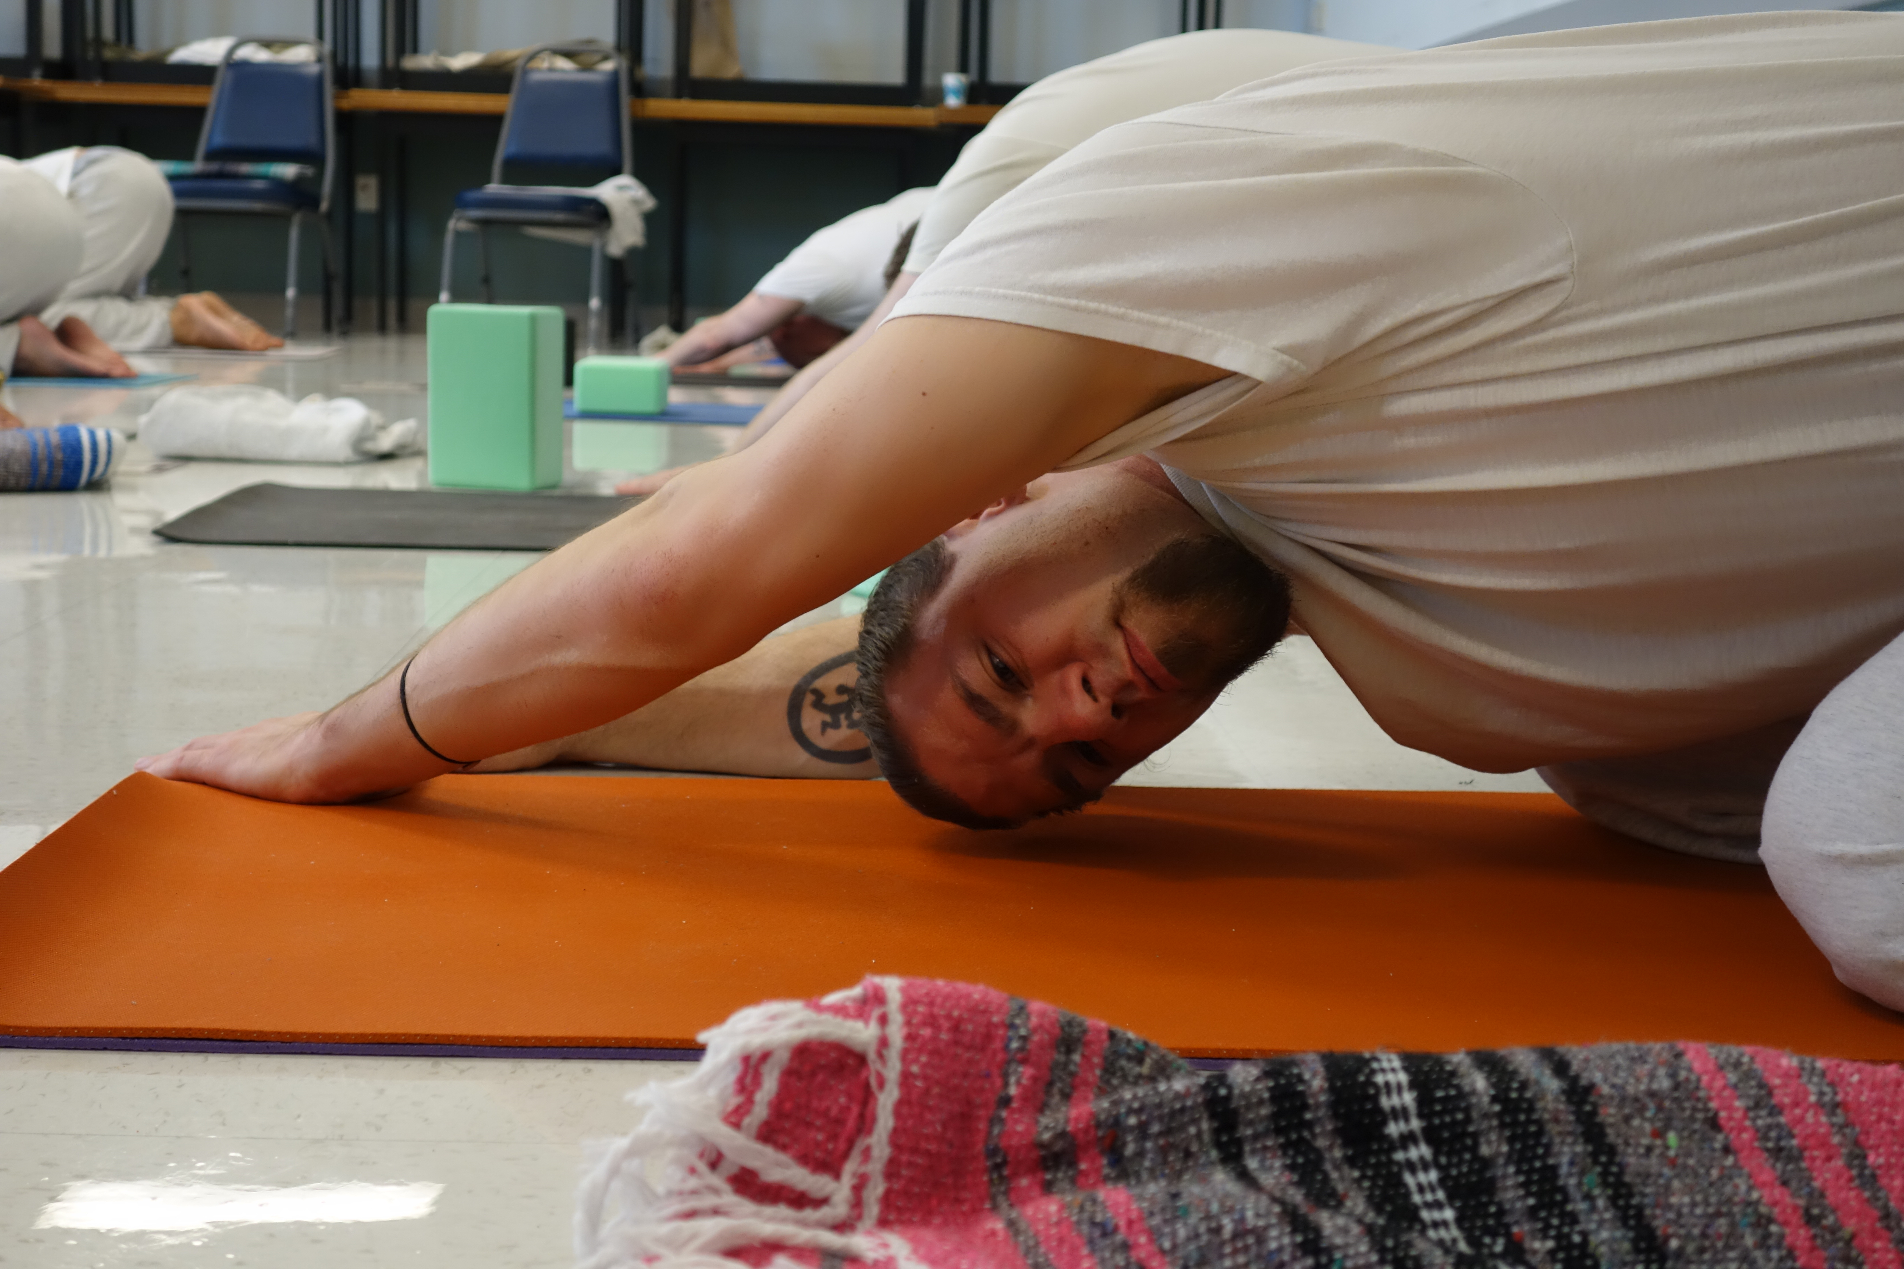
CHOICE: TRAUMA SENSITIVE LANGUAGE
Non-hierarchical choices you can offer in any setting:
Eyes closed or open
Level of exertion
Modifications
Breath
Notes:
AP
COME UP WITH EXAMPLES OF HOW TO DO IT AN DHOW NOT.
Go through braindance
Breath * Tactile * Core-Distal * Head-Tail * Upper-Lower * Body-Side * Vertical-Horizontal Eye tracking * Cross-Lateral *Vestibular
Dialogue with students
Who health is for?

Slide 23
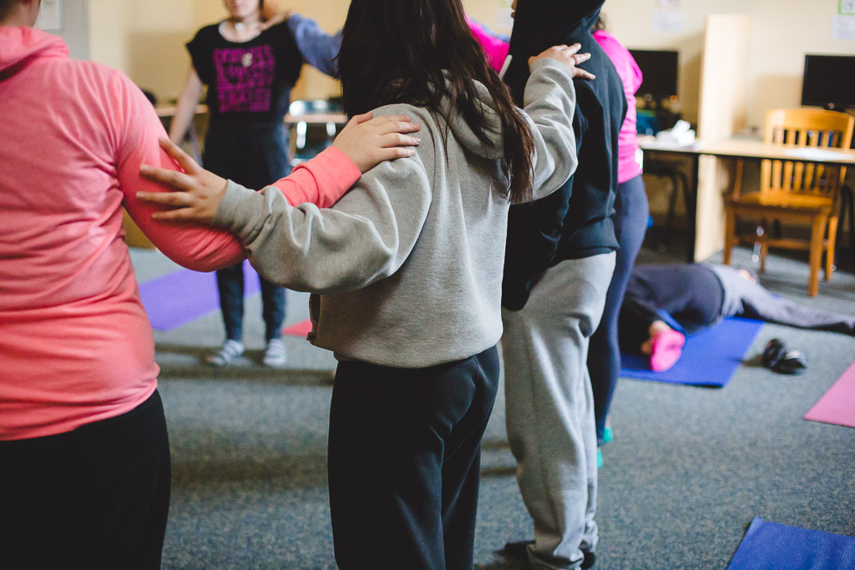
TRAUMA SENSITIVE LANGUAGE
Direct/Invitational language:
First, direct students into the movement/exercise
Then invite them to have own experience
Create rhythms—duration, count down
Body-positive, non-shaming, non-gender specific
Be cautious about making claims about benefits
Normalize “not getting it”
Praise choice-making and customization
Notes:
RV
Movement: Seated sequence from handout
Tell people we are going to be in savasana for 5 minutes
We are going to do this pose two times.
Guide people through transitions
Have people do a movement and then tell students: we’ll do this two more times. Or hold for two more breaths.

Slide 24
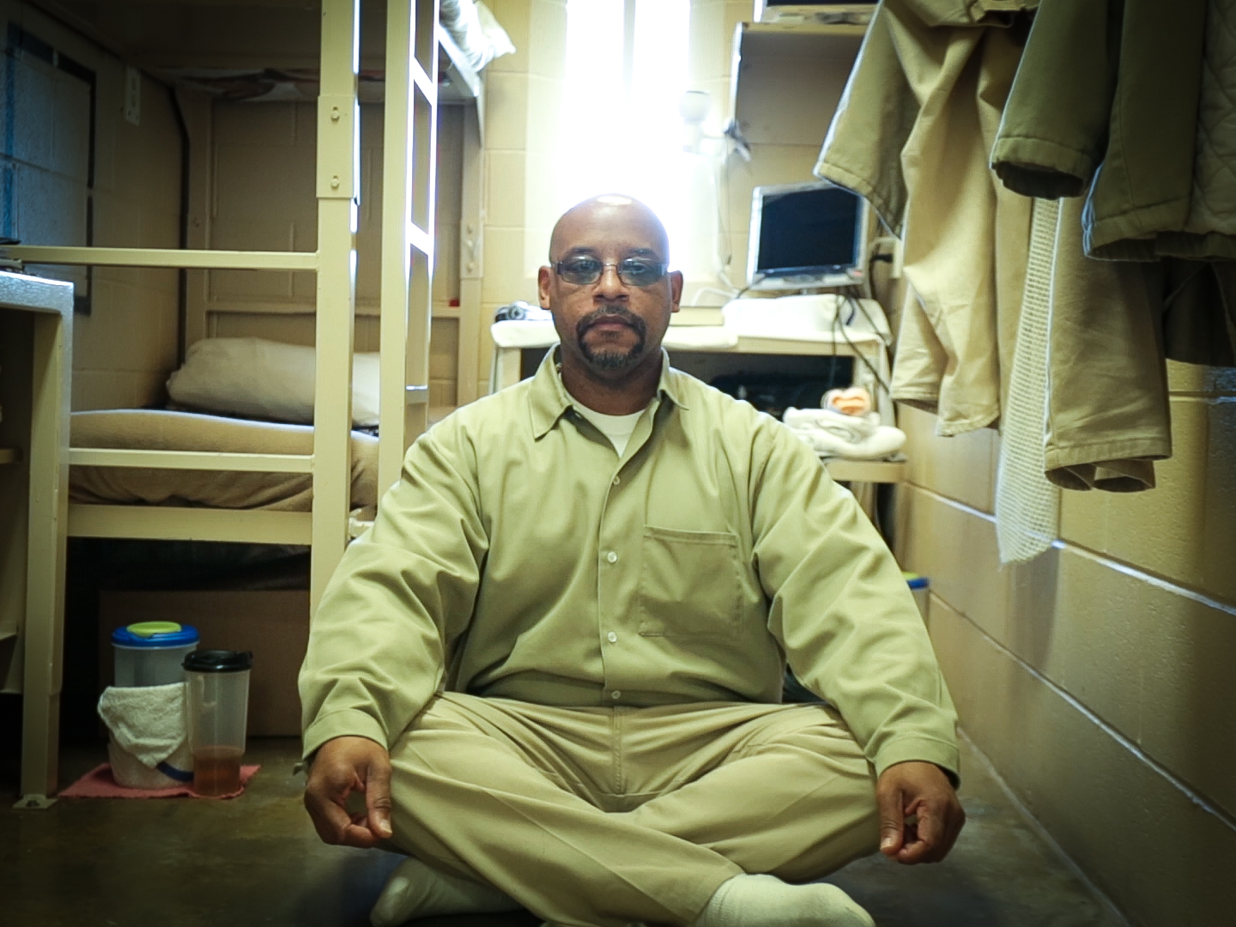
MINDFULNESS + MEDITATION
Focus on here and now
Keep students in the present moment, with their own experience
Is it relevant? Is it accessible?
Kinesthetic/Feeling Meditations
Body Scan
Moving hands with breath
Simple Imagery Meditations
Light Stream
Heart Centered Meditations
Always Give an option to ”opt out”
Notes:
AP Body Scan - great self care tool
RV Light stream meditation

Slide 25
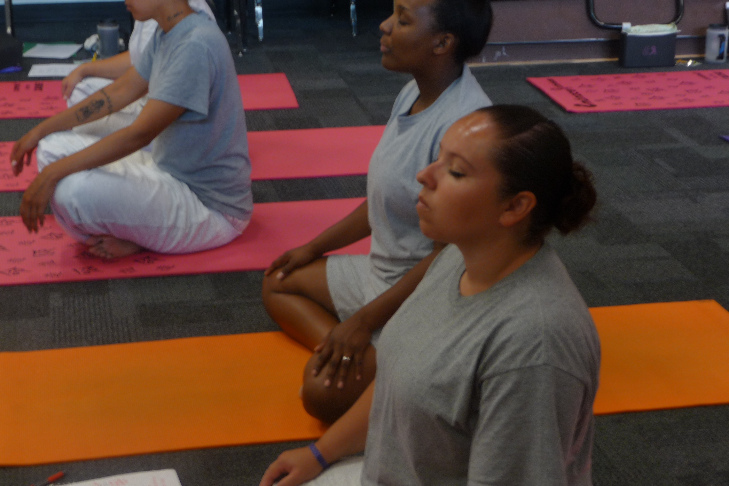
BREATH WORK
Even out the breath
Deep belly breathing
Witnessing the breath
Counting the breath
Cueing breath
Opt out
Notes:
AP
MOVEMENT: Breathing exercise
DEMONSTRATE. Focus on calming breaths, not activation. Be cautious with breath retention. NO ujjayi.

Slide 26
BENEFICIAL POSTURES EXPLORATION
ROCKING – weight shifts
FLOWING
RESTS
STANDING SHAPES
BALANCE SHAPES
GROUNDING SHAPES
SUPINE SHAPES
Notes:
Going back into your body can be very scary, please don’t push your students. These have been the most safe for us, but always use discretion.
DEMONSTRATE with Photos
Rocking, moving in and out of poses
STANDING SHAPES such as mountain pose, warrior, extended side angle
BALANCE SHAPES: tree variation, rising onto balls of feet, high lunge can be a balance pose!, balancing on hands and knees, balancing on a block
GROUNDING SHAPES: chair, modified plank, side plank variations, squats, crocodile
SUPINE SHAPES: constructive rest, easy twists, knees to chest, bridge

Slide 27
From individual to systemic change
"Yoga is both subtle and powerful. Your work is powerful, your presence in prison is important. Your presence reminds us of our humanity and it is my hope that when you speak to others about your work in prison that you remind them of ours. Because sometimes we both forget.”
Notes:
RV Body weight shift exercise

Slide 28
SUMMARY
Include trauma-informed body and mindfulness tools in your work, it’s possible!
Often these tools are more accessible than words
Practice these for yourself as much as you offer them to others
Health and wellness need to be available to all people

Slide 29
QUESTIONS

Slide 30
THANK YOU
Want to learn more? YBB Online, DVDs
Alyssa Pizarro: alyssa@yogabehindbars.org
Rosa Vissers: rosa@yogabehindbars.org

